Slide 1
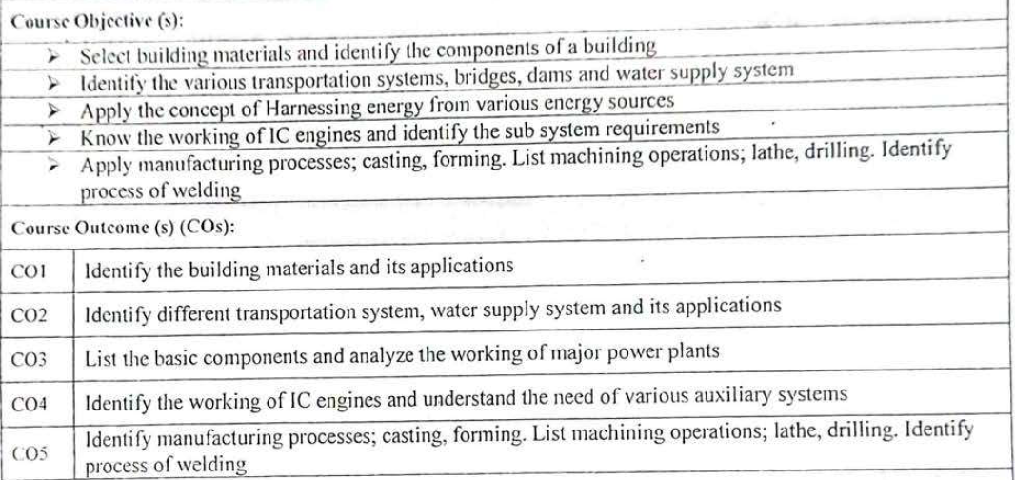
18MES102J – BASIC CIVIL AND MECHANICAL ENGINEERING
(Regulation – 2018)

Slide 2
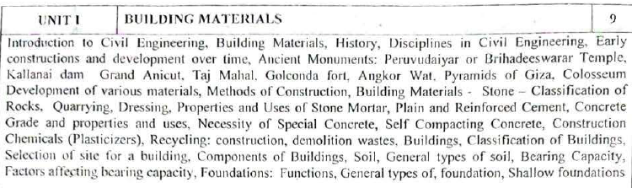
Unit – 1
Building Materials
Unit – 2
Transportation and Water System
Unit – 3
Power Plants
Unit – 4
Internal Combustion Engine
Unit – 5
Casting and Forming Process

Slide 3
Building Materials
Introduction to Civil Engineering
sand
timber
ancient monuments
Bricks
Stones
Cement
Recycling – Constructional Waste
Classification of Buildings
Soils
Foundations

Slide 4
Introduction to Civil Engineering
The buildings we live in and work in, the transportation facilities we use, the water we drink, and the drainage and sewage systems.
Civil Engineers:
Measure and map the earth’s surface.
Design and supervise the construction of bridges, tunnels, large buildings, dams, and coastal structures.
Plan, layout, construct, and maintain railroads, highways, and airports.
Devise systems for the control and efficient flow of traffic.
Plan and build river navigation and flood control projects.
Provide plants and systems for water supply and sewage and refuse disposal.

Slide 5
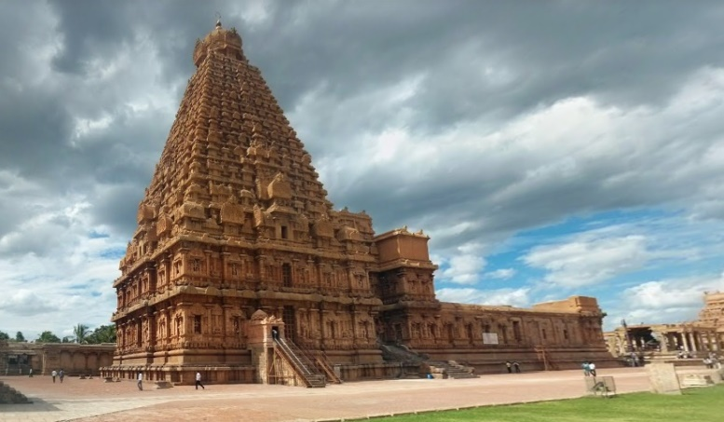
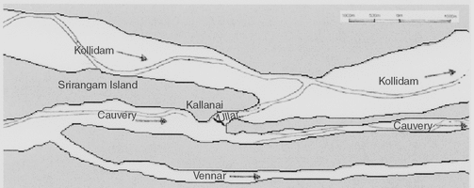
Ancient Monuments
Brihadeeswarar Temple (PeruvudaiyarKovil)
Raja RajaChola I in the year 1010 AD, This ancient shrine is situated at Thanjavur district in Tamil Nadu.
Temple tower has an elevation of 66 meters.
Nandi at the entry of this Brihadeeshwar
13 feet in elevation and 16 feet in length
Kallanai dam - Grand Anicut
The Kallanai Dam was built during the second century AD by Karikalan
simple check dam
300 meters long, 20 meters wide,
and 4.5 meters high.
1 million acres
Kallanai has been altered after the 1800s

Slide 6
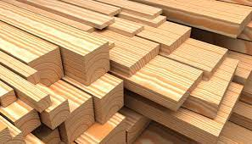
Requirement of timber
Dark uniform colur
Dense
Workable,good machinability.
Uniform texture
Freshly cut log surface should emit sweet smell.
Free from crakes,splits,warp,etc.
When it is struck,it should produce a sonorous sound.

Slide 7
Classification of Buildings
Residential Buildings
Educational Buildings
Institutional Buildings
Assembly Buildings
Business Buildings
Mercantile Buildings
Industrial Buildings
Storage Buildings
Hazardous Buildings

Slide 8
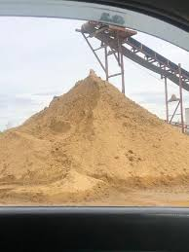
Sand
Requirement of sand
It should be clean.
It should be well graded.
Maximum permissible clay content is 3 to 4% in sand
It should not contain salts which attract
Moisture from the atmosphere.
It should contain sharp,angular grains.

Slide 9
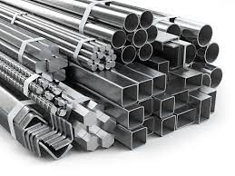
Metal
They should provide sufficient strength to bear the loads coming on them
They should provide resistance to corrosion and weather actions
They should provided resistance to heat and fire .
They should have good adhesion the cement concrete.

Slide 10
Uses of stones
They are used in hydraulic like dams and beidges.
They are used as road metals in road construction.
They are used to make concrete in the form of course aggregate.
They used a ballast form oermanent way in railways.

Slide 11
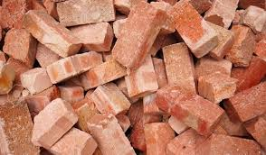
Building Materials
Manufacturing of bricks
In the process of manufacturing bricks, the following distinct operations are involved.
Preparation of clay
(i)Unsoiling (ii)Digging (iii)Cleaning (iv)Weathering (v)Blending Tempering
Moulding
(i)Hand Moulding (ii)Machine Moulding
Drying
The damp bricks are likely to be cracked or distorted unless dried.
Burning
(i)Clamp Burning (ii) Kiln Burning

Slide 12
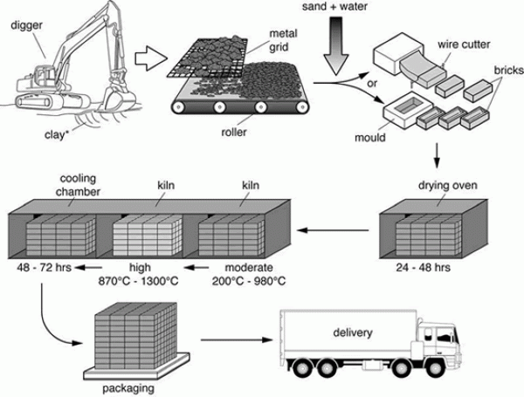
Building Materials
Bricks

Slide 13
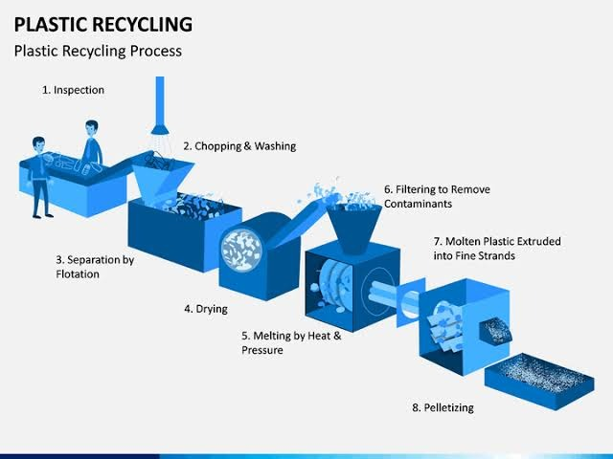

Slide 14
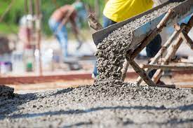
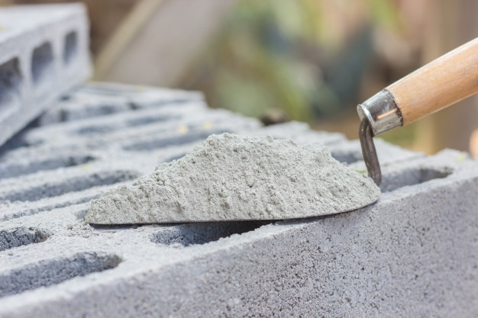
Cement
1.cement is obtained by burning the mixture of calcareous and argillaceous materials and crushing into fine powder.
2.Very small amount of sulphur is added.
3.It should be fine powder.

Slide 15
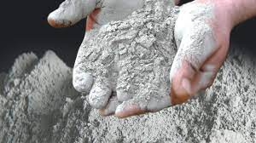
Uses of cement
1.Making joints for drains,pipes. 2.Construction of buildings, bridges,tanks,domes,flyovers,dockyard,etc..,
3.Used to prepare cement mortar for constructions,plaster,painting,floorings,etc..,

Slide 16
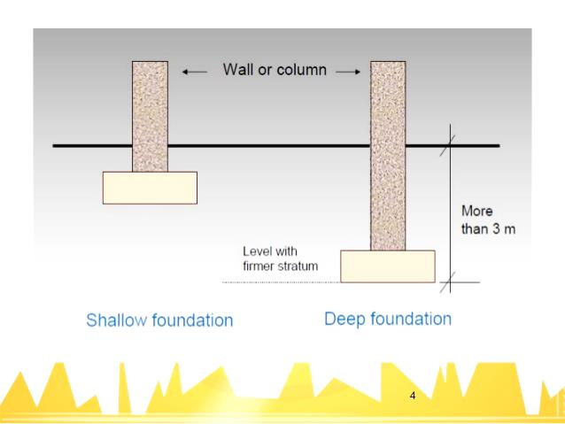
Foundations
Foundation are classified as shallow and deep foundations. Types fo foundations under shallow and deep foundations for buildind consyructions and their uses are discussed

Slide 17
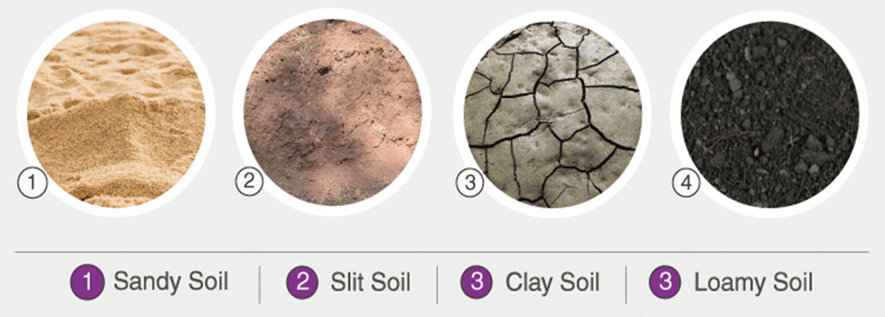
soils
The upper layer of earth in which plants grow, a black or dark brown material typically consisting of a mixture of organic remains , clay, and rock particles.

Slide 18
General types of soil
• Clay- soil has the smallest particles among the three so it has good water
storage qualities.
• Sandy- Soil has the largest particles among the different soil types
• Silty- soil has much smaller particles than sandy soil
• Peaty- Peaty soil is dark brown or black in color, soft, easily compressed
due to its high water content, and rich in organic matter
• Chalky- Sometimes called basic soils, they are always very
alkaline. Chalk is a solid, soft rock which breaks down easily. It is very free
draining, and chalky soils hold little water and dry out easily.

Slide 19
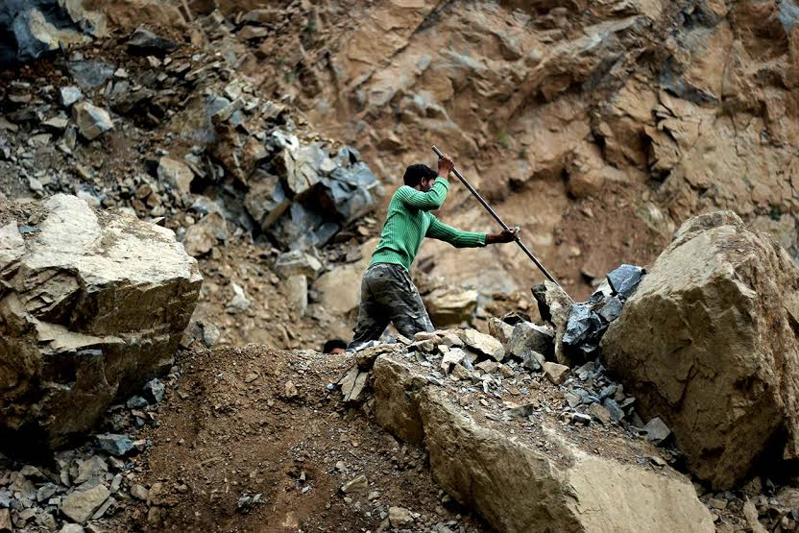
Stone quarrind
The process of raking out stones from natural rock beds is known as the quarrying. The term quarry is used to indicate the exposed surface of natural rocks

